Slide 1
SWIMMING
LESSONS
Social Story

Slide 2
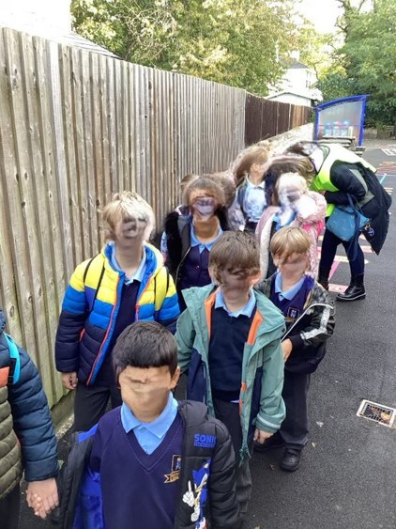
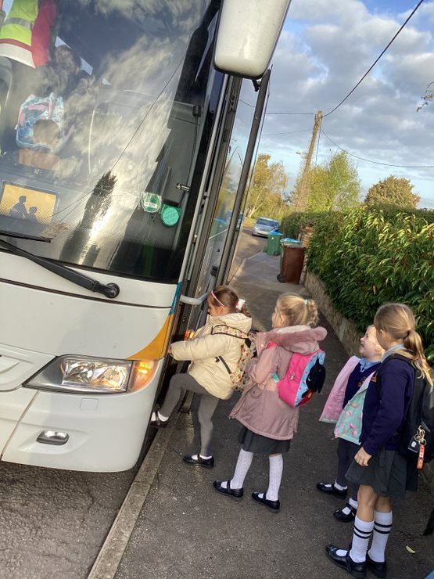
I have a partner for the coach.
We get on the coach.

Slide 3
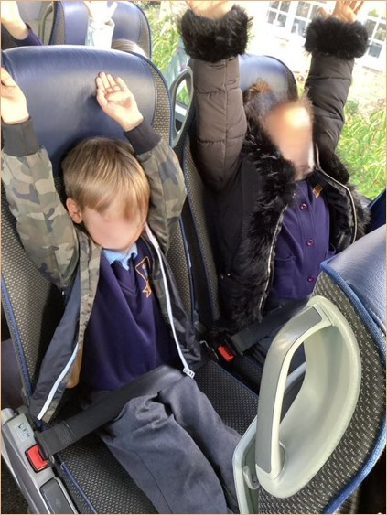
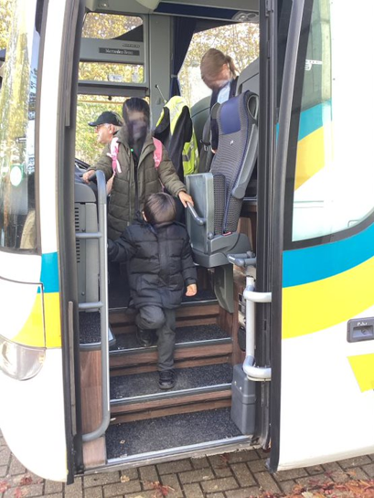
We put on our seatbelt.
We travel to Aylesbury then
we get off the coach.

Slide 4
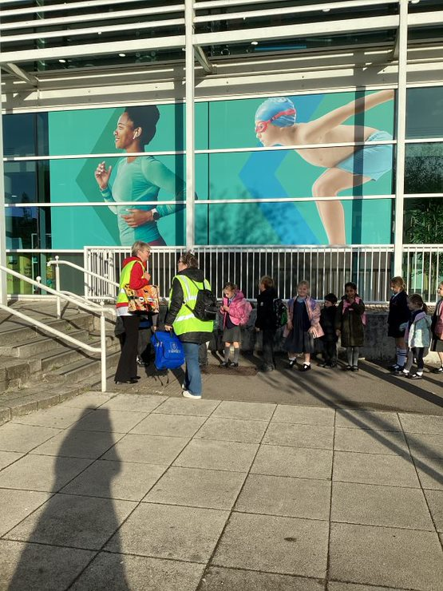
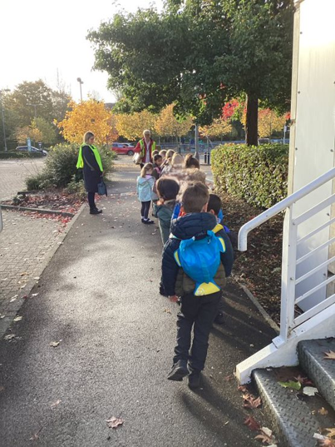
We all line up, ready to
be counted.
We walk to the steps.

Slide 5
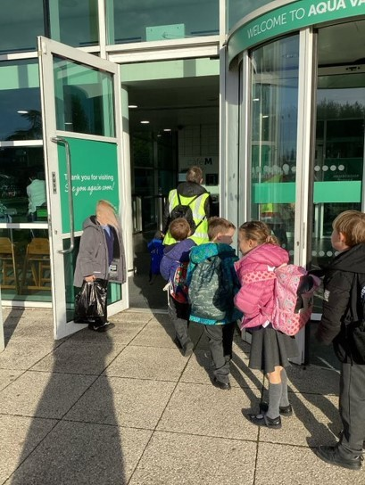
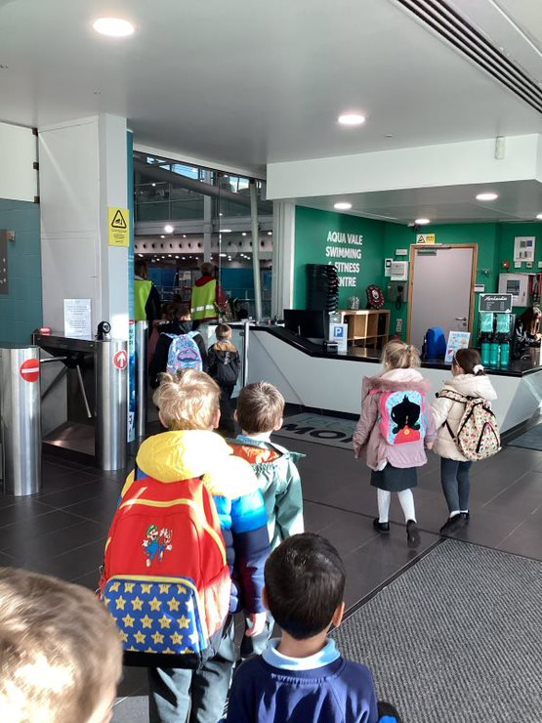
A year 2 holds the door
open.
We collect the keys for
the changing rooms.

Slide 6
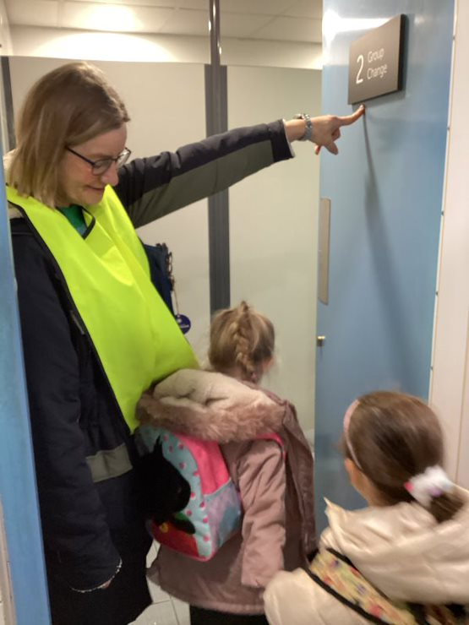
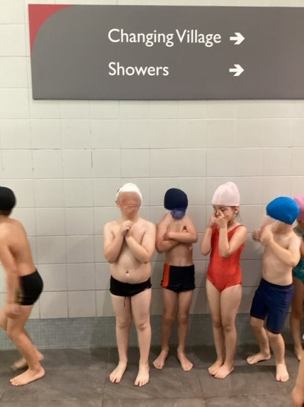
We get undressed and put
on our swimming kit.
Into the changing rooms.

Slide 7
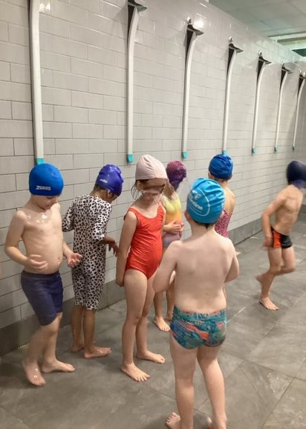
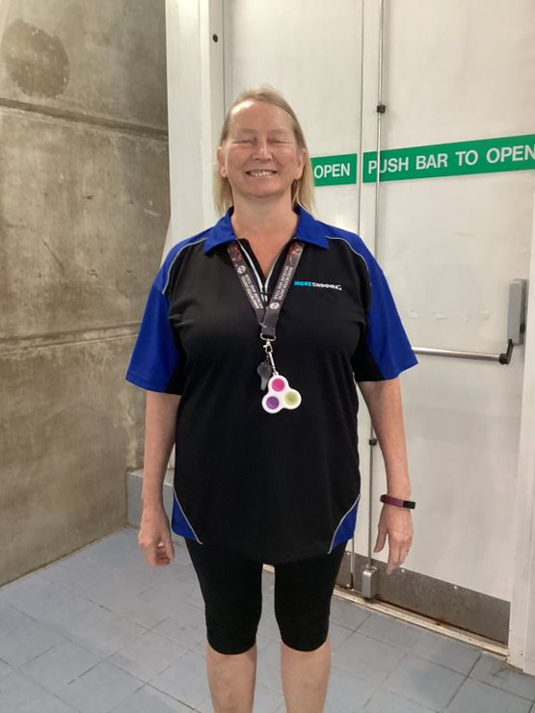
Hello Carolyn
This is my swimming teacher.
We have a quick shower.

Slide 8
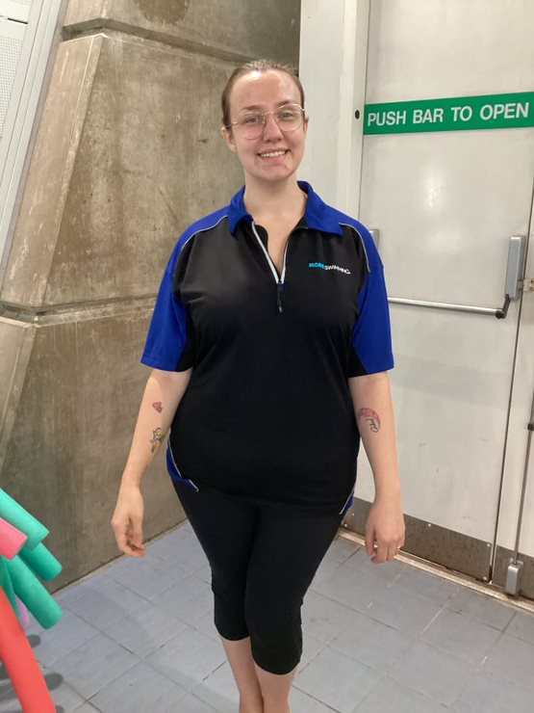
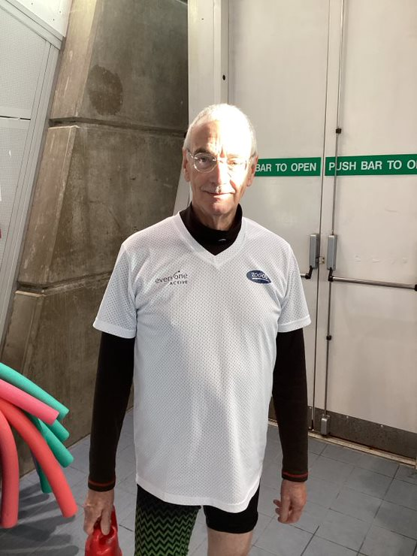
Hello Maisie
Maisie is also a swimming
teacher.
Hello Alan
Alan is a swimming teacher.
He gets into the pool.

Slide 9
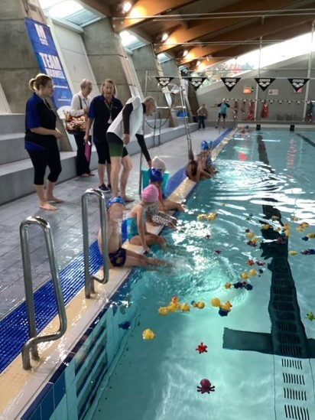
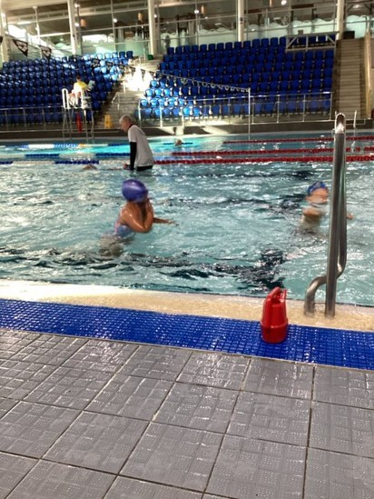
We sit on the side of the
pool and wait for instructions.
We then take part in swimming
activities for 30 minutes.

Slide 10
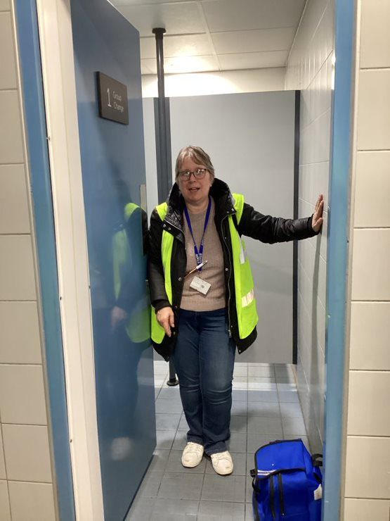
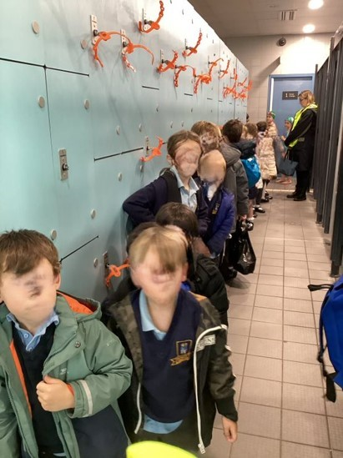
Out of the pool. Quick shower,
then back into the changing
rooms.
We put our clothes back
on and then line up.

Slide 11
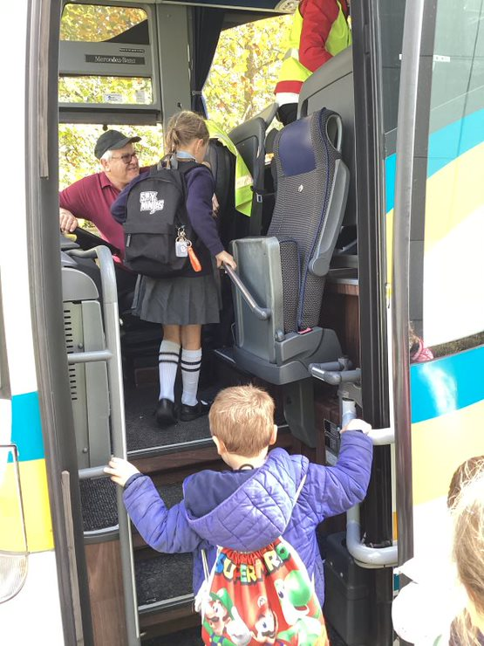
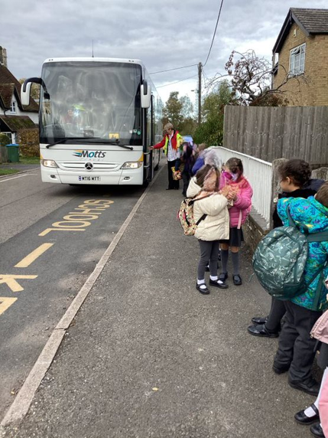
Back on the coach.
Back to school.

