Slide 1
Door Moments
How do others feel?

Slide 2
What might faith look like?

Slide 3
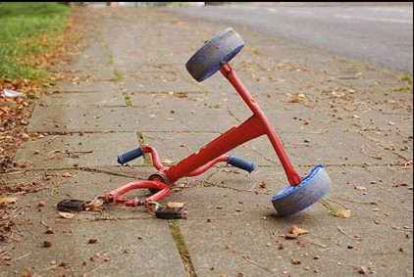
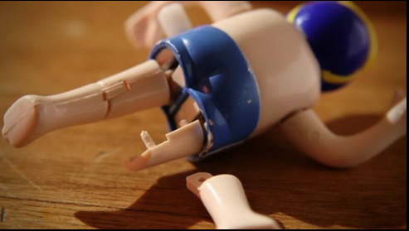
Is faith a feeling?
What do you notice about these pictures?
How would it make us feel if this happened to us?
Who has faith?

Slide 4



A message of faith
If you could send a message of faith what would it say?
Who would it be for?

Slide 5

Don’t forget to Remember

Slide 6

Having faith

Slide 7
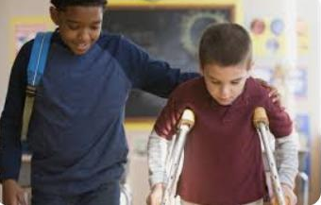
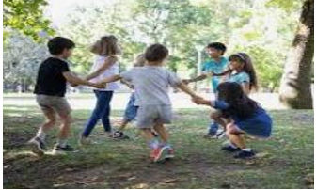
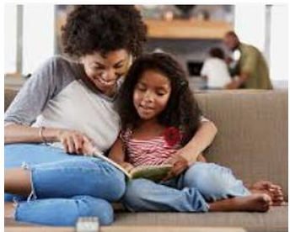
Connecting to others.
How are connected to others?
Adorable Kids and Dogs Growing Up Together | The Dodo Soulmates

Slide 8
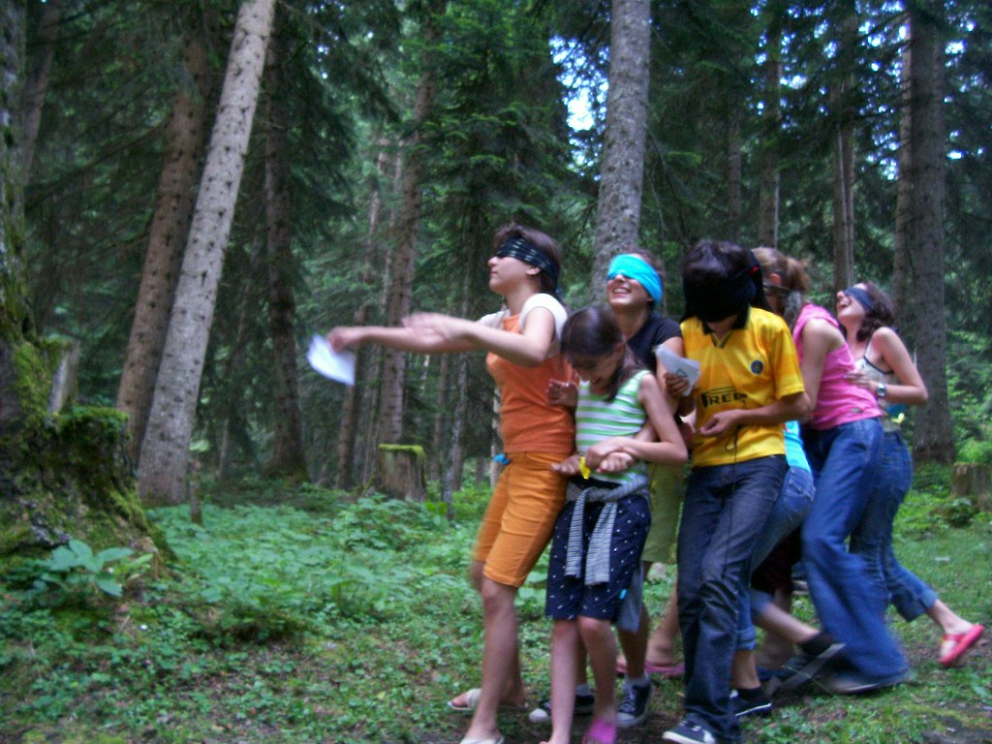
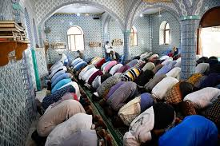
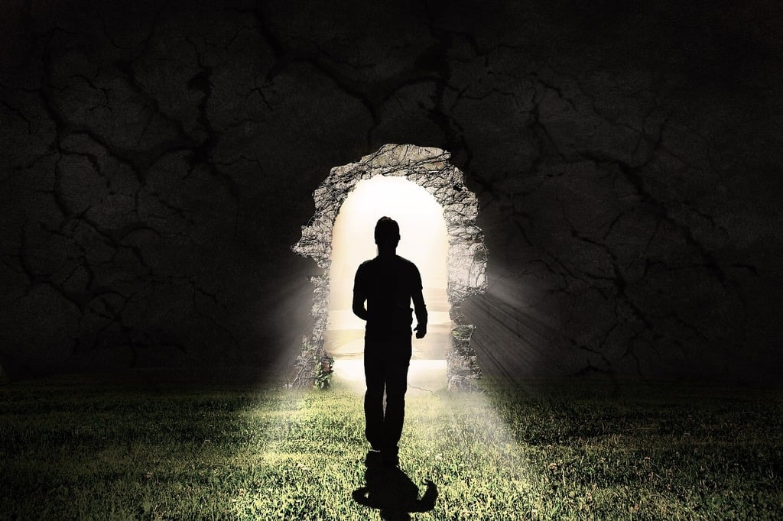
Who do you have faith in?

Slide 9
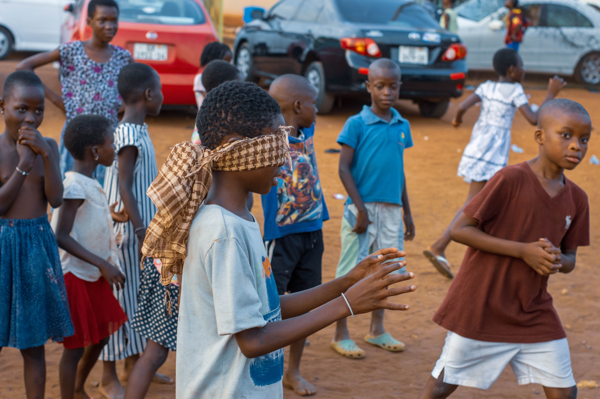
Can you put your faith in someone else's hands?

Slide 10
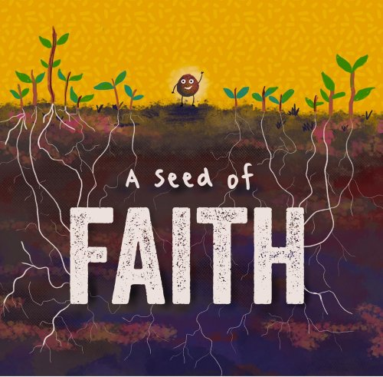
A Seed of Faith

Slide 11
Reflection
What does having faith mean to you?
How did today make you feel?
What would it be like if we didn’t have faith?

