Slide 1
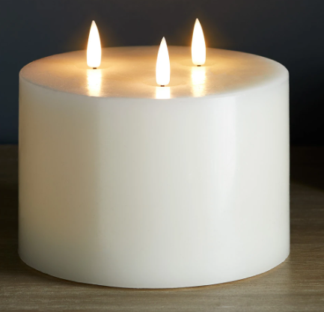
Candle Prayer
We light this candle to remind us of God the Father, God the Son and God the Holy Spirit.
‘Teach children how to live and we will remember it all our lives’ Proverbs 22.6

Slide 2
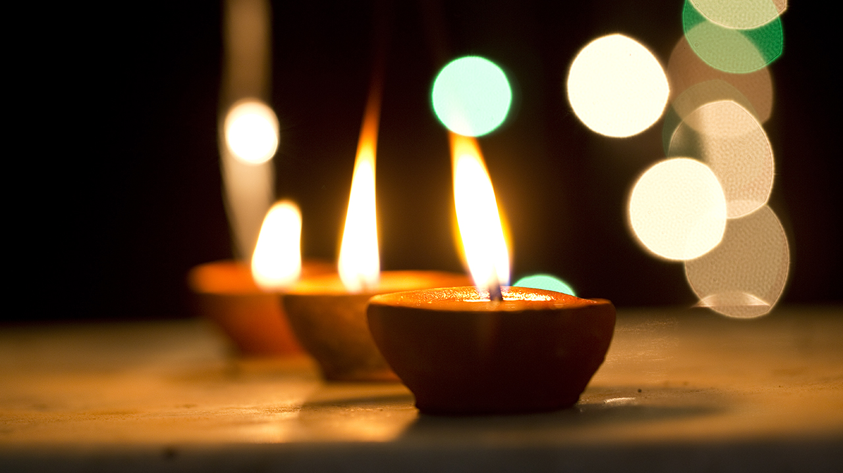
SPIRITUALITY
February 2025

Slide 3
Window Moments
Looking at the world in new ways.
What amazing things can you see?

Slide 4
God’s Good Earth
BBC Nature - David Attenborough - Wonderful World (youtube.com)

Slide 5
What amazing things can you see?

Slide 6
Should we be thankful for it?
Are we spoiling God’s good Earth?
Are we damaging the Earth?
The beauty of the earth is celebrated in many religions, but the human spoiling of the earth is a danger and becoming a crisis.

Slide 7
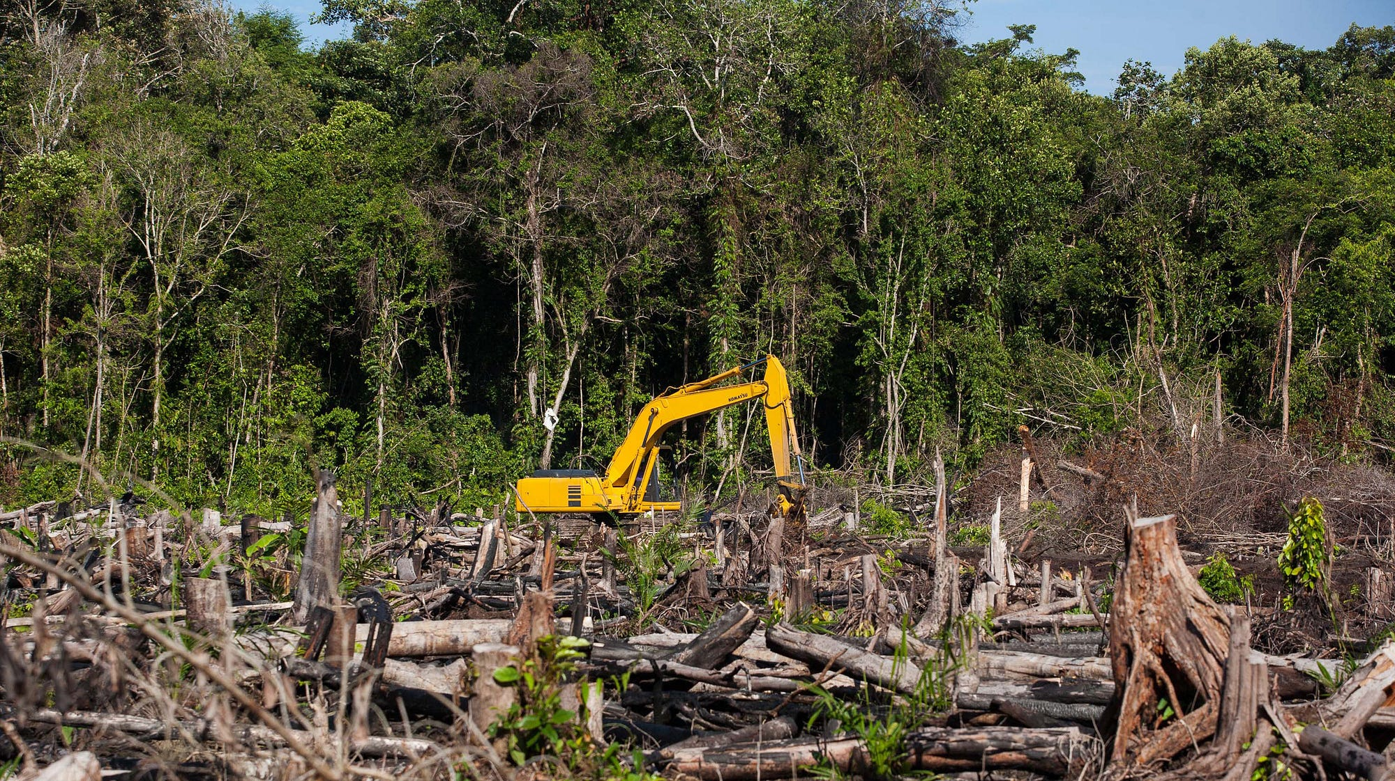
Deforestation

Slide 8
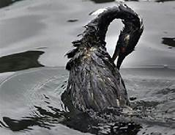
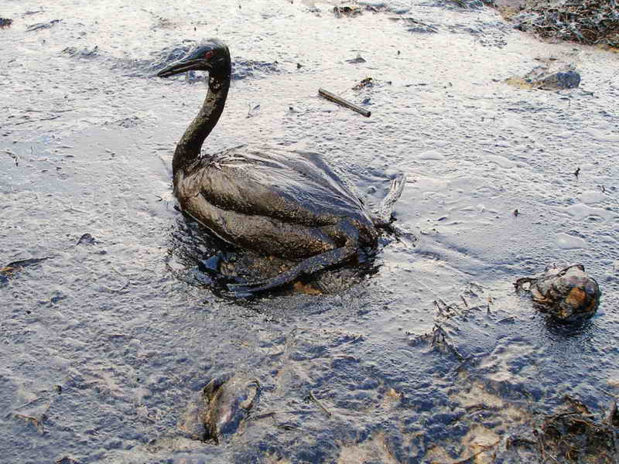
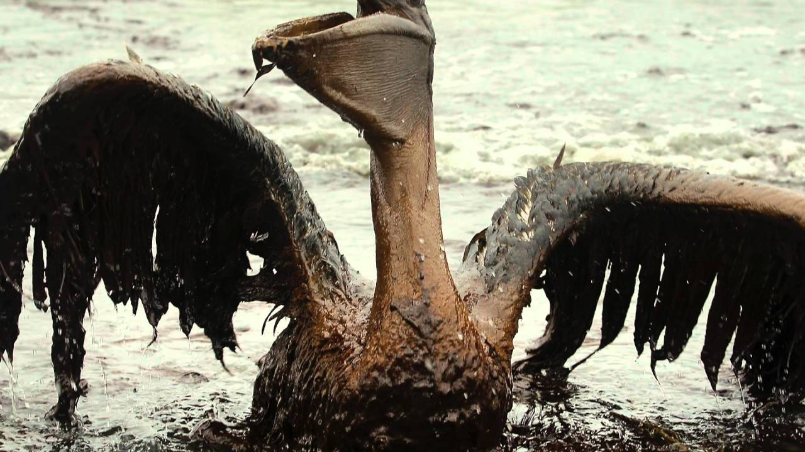
Oil Spillages

Slide 9
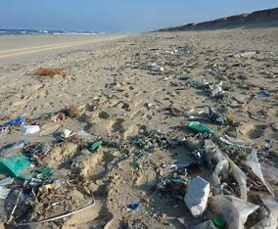
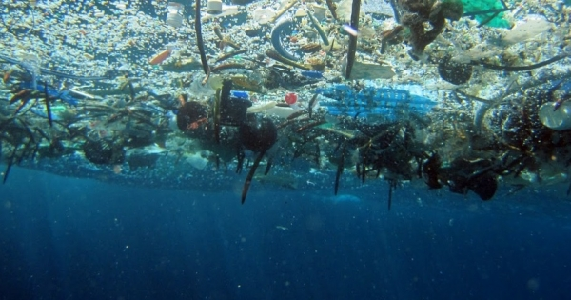
Plastic Pollution

Slide 10
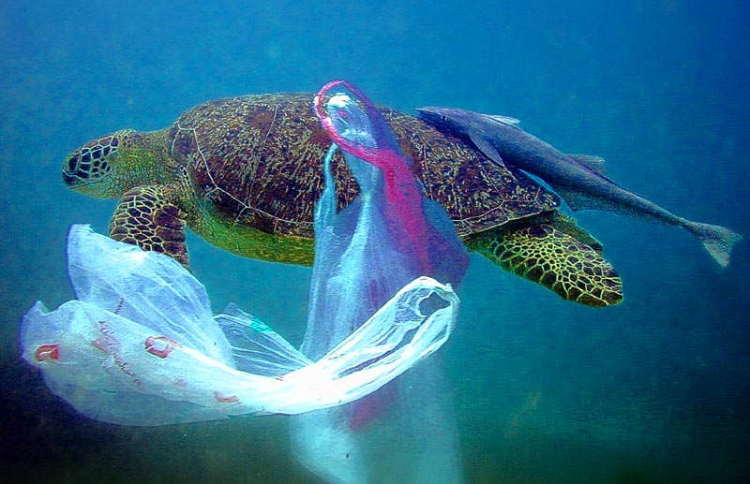

Slide 11



Slide 12
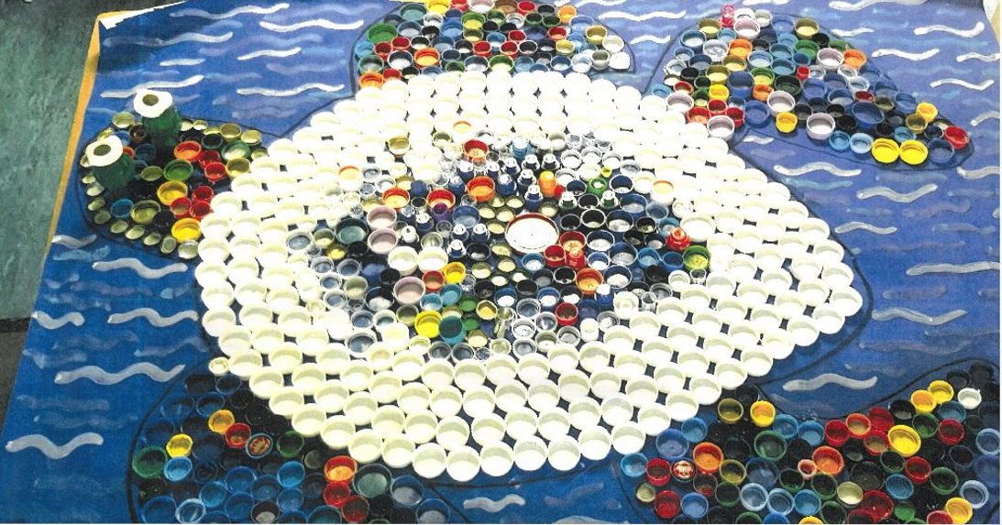

Slide 13
Plastic Pollution Facts
Plastic makes up 90% of all rubbish floating on the ocean’s surface.
Every year, plastic in our oceans kills 1 million sea birds and 100,000 marine mammals.
It takes 500 to 1000 years for plastic to break down.

Slide 14


Slide 15
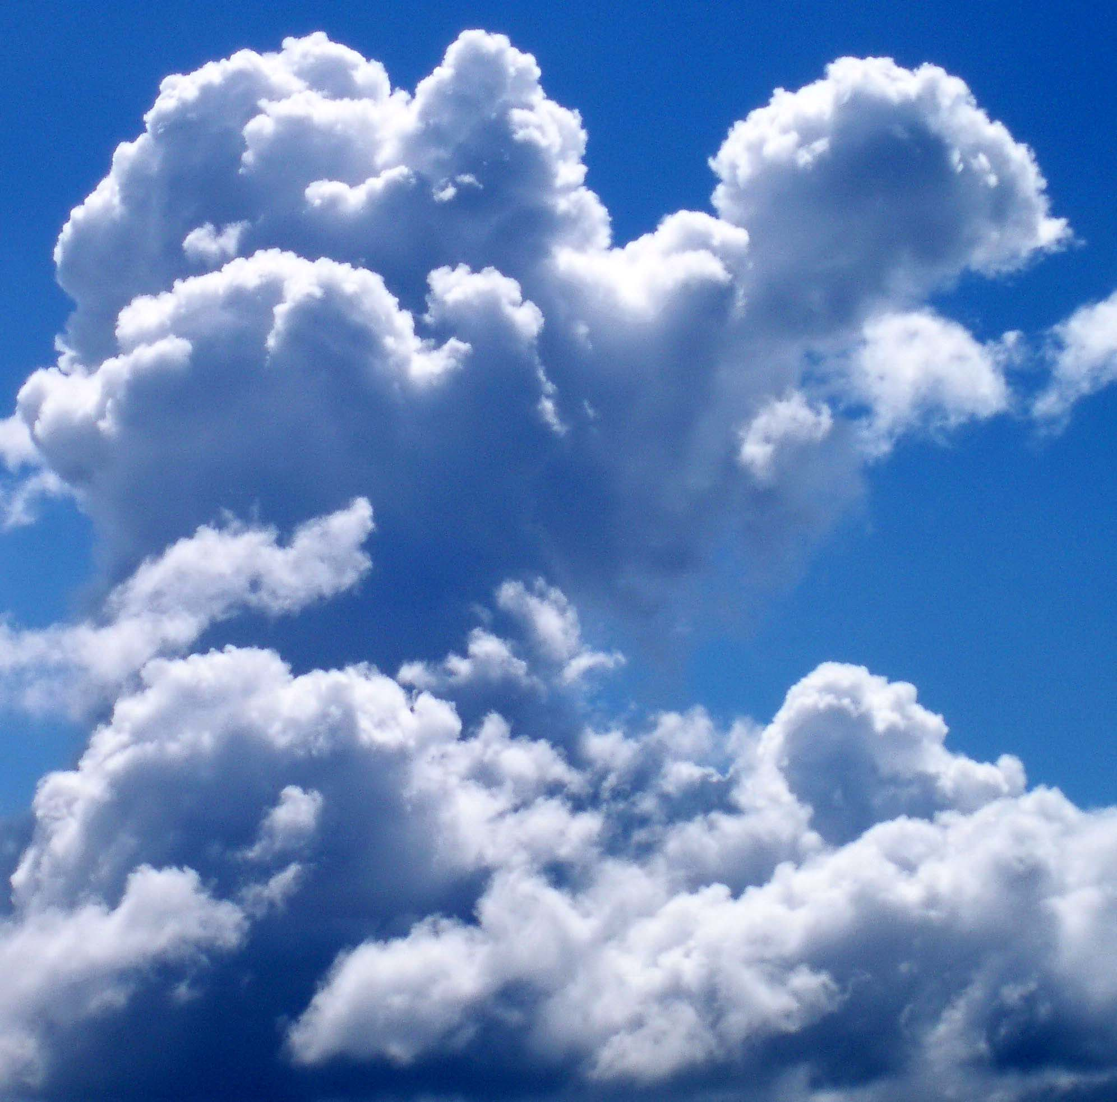
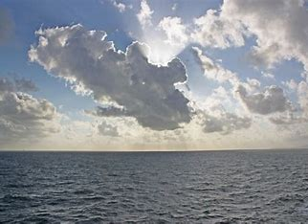
Be still. Take a moment and look at the sky.
What amazing things can you see?

Slide 16
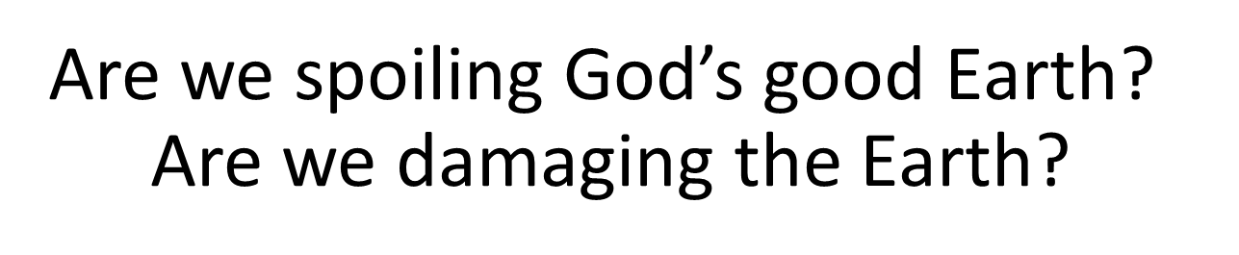

Slide 17
Thank You

Slide 18



The 3 'R's
Reduce
Reuse
Recycle
Buy only what you need because a better way to reduce waste is by not creating it.
If you have to acquire goods, try getting used ones or obtaining substitutes.
When discarding your waste, find ways to recycle it instead of letting it go to landfill.

