Slide 1
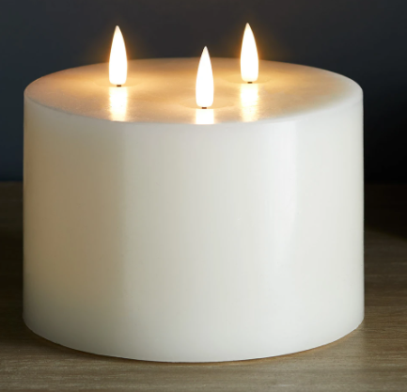
Candle Prayer
We light this candle to remind us of God the Father, God the Son and God the Holy Spirit.
‘Teach children how to live and we will remember it all our lives’ Proverbs 22.6

Slide 2
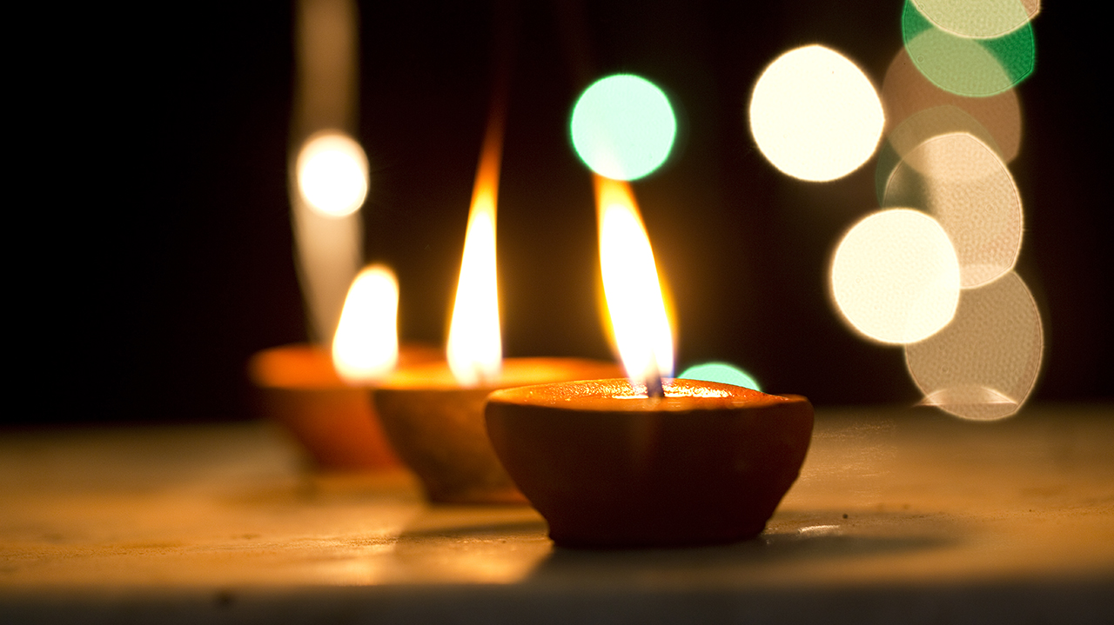
SPIRITUALITY
2024

Slide 3

Mirror Moments Reflection
‘Teach children how to live and we will remember it all our lives’ Proverbs 22.6
Notes:
What is this? What do we see when we look in the mirror?

Slide 4
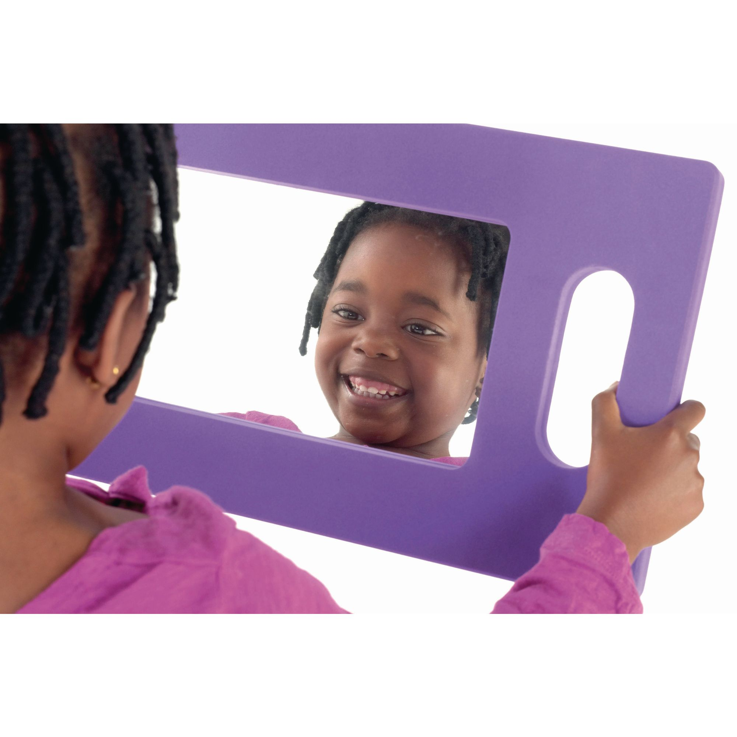
‘Mirror moments’
How much time do we think about who we are and what is special about us?
‘Teach children how to live and we will remember it all our lives’ Proverbs 22.6
Notes:
What would we see if we could look at ourselves on the inside? What special qualities would we see? Illustrate with staff.

Slide 5
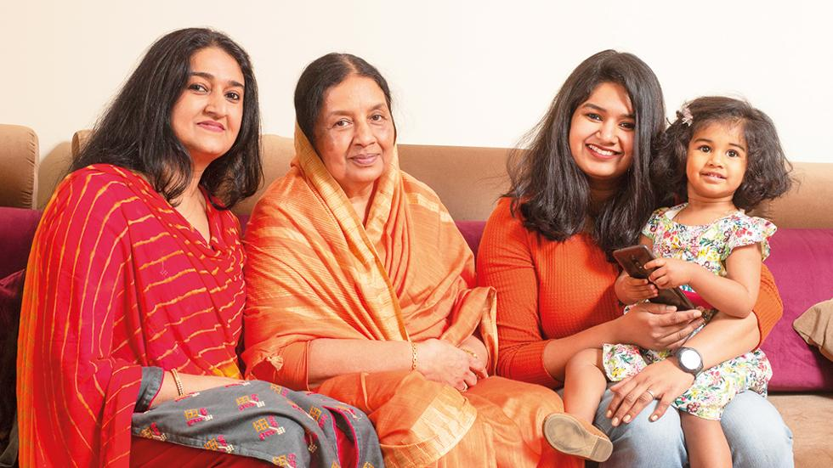
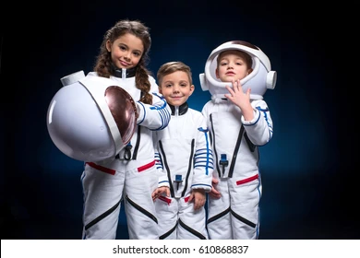
Do we ever think about what we hope to be like in the future?
‘Teach children how to live and we will remember it all our lives’ Proverbs 22.6

Slide 6
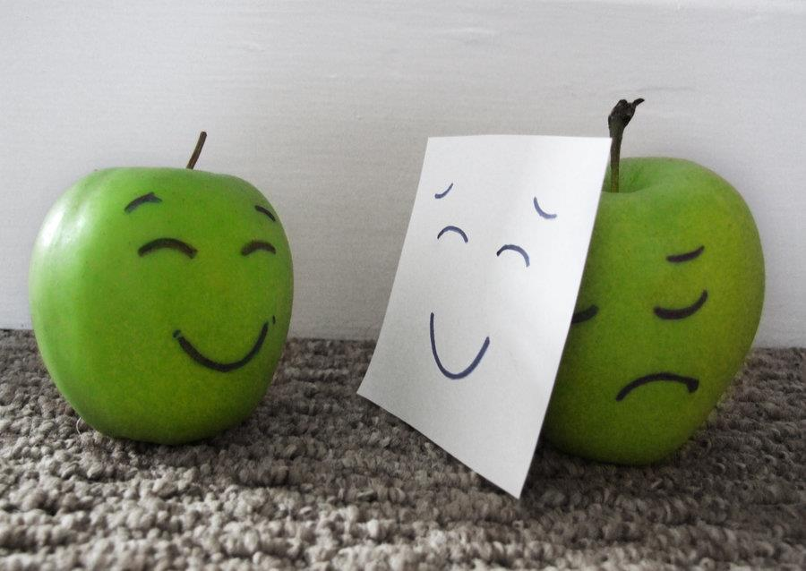
…Do we ever hide from other people how we are truly feeling inside?
‘Teach children how to live and we will remember it all our lives’ Proverbs 22.6

Slide 7
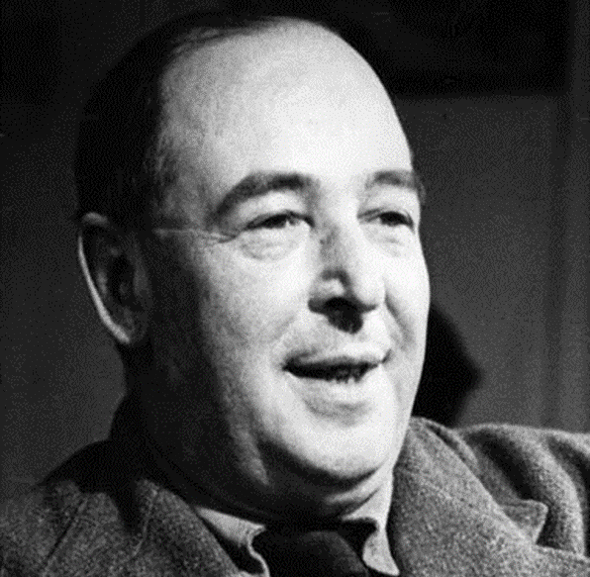
The famous author CS Lewis said, ‘Though our feelings come and go, God’s love for us does not’.
Christians believe that we can all experience God’s love all the time. We may have feelings about ourselves and others that change from time to time, but in God’s eyes we are all special and unique creations worthy of his love.
Remember – you are unique and special!
‘Teach children how to live and we will remember it all our lives’ Proverbs 22.6

Slide 8
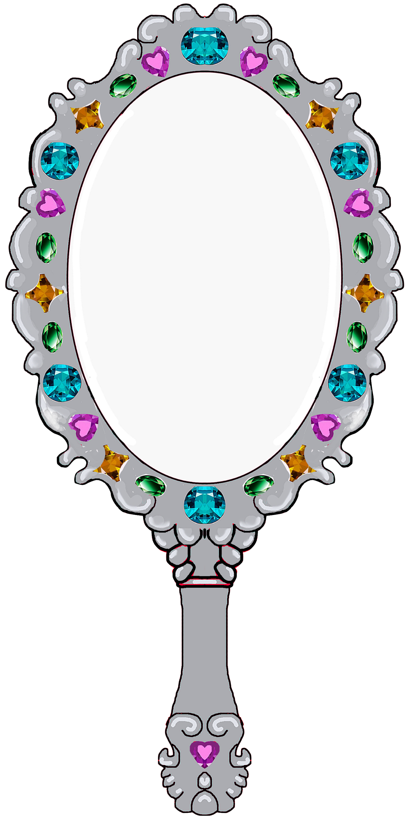


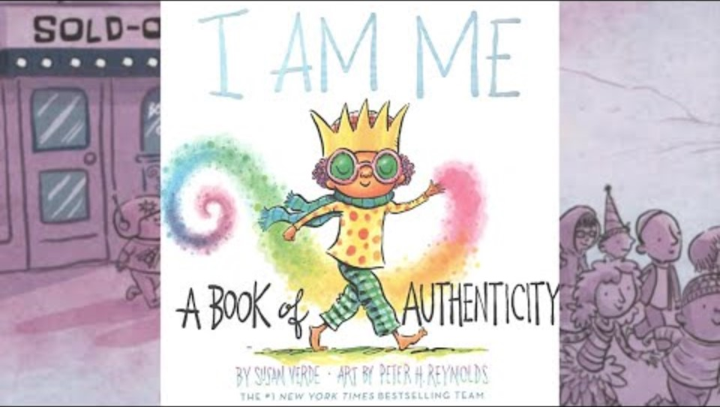
I am me! God loves me!
‘Teach children how to live and we will remember it all our lives’ Proverbs 22.6

